Slide 1
Session 3a
DNA; Mutations; and Genetics

Slide 2
Specific biomolecules serve various functions in the body.
Study the statement above. Identify the molecule which contains the instructions used to create an organism’s enzymes and proteins.
a. nicotinamide adenine dinucleotide (NAD+)
b. hemoglobin
c. deoxyribonucleic acid (DNA)
d. glucose

Slide 3
Specific biomolecules serve various functions in the body.
2. RNA molecules use instruction from DNA to assemble proteins. There are three types of RNA molecules: mRNA, rRNA and tRNA. What specific function does mRNA perform in the process of making proteins?
a. It brings instructions from DNA in the cell nucleus to the cytoplasm.
b. It clamps onto messenger RNA and uses its information to assemble amino acids.
c. It transports amino acids to the ribosomes to be assembled into proteins.
d. It creates another molecule of DNA through replication.

Slide 4
Specific biomolecules serve various functions in the body.
3. Which of the following correctly shows a complementary base pair of nitrogenous bases in a DNA molecule?
a. adenine- guanine
b. guanine- cytosine
c. cytosine- adenine
d. guanine- thymine

Slide 5
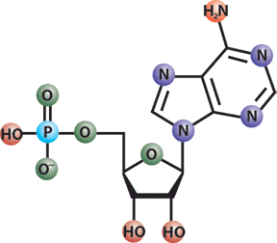
Specific biomolecules serve various functions in the body.
4. DNA is a polymer which is made up of subunits called nucleotides. Nucleotides have three basic parts. Which of these is not a nucleotide component?
a. deoxyribose sugar
b. phosphate group
c. ribose sugar
d. nitrogenous base

Slide 6
5. A nitrogenous base is an important component of the nucleotide making up DNA. Which of the following correctly lists the four possible nitrogenous bases in DNA?
a. adenine, guanine, cytosine, uracil
b. leucine, proline, tyrosine, phenylalanine
c. glutamine, proline, tyrosine, phenylalanine
d. adenine, guanine, cytosine, thymine

Slide 7
6. Translation is crucial to the process of making proteins. Which statement best describes what takes place during translation?
a. An RNA copy of a DNA strand is made.
b. Information in mRNA is converted into a sequence of amino acids in a protein.
c. A copy of chromosomal DNA is created.
d. Instructions from DNA in the nucleus are brought to the cytoplasm.

Slide 8
7. In order for DNA instructions to move from the nucleus to the ribosomes in the cytoplasm of a cell, an RNA copy of a DNA strand must be made. This process, which takes place in the cell nucleus, is called-
a. translation
b. DNA replication
c. mutation
d. transcription

Slide 9
8. John has one recessive allele for blue eyes (b) and one dominant allele for brown eyes (B). Amy also has one recessive allele for blue eyes and one dominant allele for brown eyes. What phenotype is an offspring of John and Amy most likely to express?
a. Bb
b. BB
c. blue eyes
d. brown eyes

Slide 10
Gregor Johann Mendel was an Austrian monk who is considered to be the father of genetics. In the 1850’s Mendel began doing experiments on pea plants. In one experiment Mendel took one pea plant with smooth seeds and crossed it with another pea plant with wrinkled seeds. Then he looked at the offspring from this cross. He found that all of the offspring produced only smooth seeds. In his experiments, Mendel was careful to use only pure-breeding strains of peas.
Wrinkled Smooth
9. Refer to the information above. Which statement is true about pure strains?
a. Pure-breeding strains arise from self-pollination.
b. Pure-breeding strains do not produce pollen.
c. Pure-breeding strains produce seed faster than non-pure plants.
d. Pure-breeding strains are easier to cross-pollinate.

Slide 11
Gregor Johann Mendel was an Austrian monk who is considered to be the father of genetics. In the 1850’s Mendel began doing experiments on pea plants. In one experiment Mendel took one pea plant with smooth seeds and crossed it with another pea plant with wrinkled seeds. Then he looked at the offspring from this cross. He found that all of the offspring produced only smooth seeds. In his experiments, Mendel was careful to use only pure-breeding strains of peas.
Wrinkled Smooth
10. Refer to the information above. Which statement is true about pure strains?
a. Pure-breeding strains grow more quickly than regular plants.
b. Pure-breeding strains have traits that skip generations.
c. Pure-breeding strains allowed Mendel to uncover the law of genetics.
d. Pure-breeding strains are hybrids.

Slide 12
Gregor Johann Mendel was an Austrian monk who is considered to be the father of genetics. In the 1850’s Mendel began doing experiments on pea plants. In one experiment Mendel took one pea plant with smooth seeds and crossed it with another pea plant with wrinkled seeds. Then he looked at the offspring from this cross. He found that all of the offspring produced only smooth seeds. In his experiments, Mendel was careful to use only pure-breeding strains of peas.
Wrinkled Smooth
11. Refer to the information above. Why did the offspring of Mendel’s cross all have smooth seeds?
a. The wrinkled trait showed incomplete dominance.
b. The smooth trait was dominant.
c. The wrinkled trait was lost by spontaneous mutation.
d. The offspring did not contain the gene for the wrinkled trait.

Slide 13
Gregor Johann Mendel was an Austrian monk who is considered to be the father of genetics. In the 1850’s Mendel began doing experiments on pea plants. In one experiment Mendel took one pea plant with smooth seeds and crossed it with another pea plant with wrinkled seeds. Then he looked at the offspring from this cross. He found that all of the offspring produced only smooth seeds. In his experiments, Mendel was careful to use only pure-breeding strains of peas.
Wrinkled Smooth
12. Refer to the description above. After doing the initial cross with smooth and wrinkled peas, Mendel then took the offspring (all smooth) and crossed them with each other. If Mendel looked at 1000 seeds in the next generation, approximately how many seeds would you expect to show each trait?
a. 500 smooth seeds, 500 wrinkled seeds
b. 750 smooth seeds, 250 wrinkled seeds
c. 1000 smooth seeds, 0 wrinkled seeds
d. 1000 wrinkled seeds, 0 smooth seeds

Slide 14
13. Bill grows two varieties of corn in his garden. One variety produces large ears of corn and one makes small ears of corn. When Bill crosses the two plants the resulting ears of corn are medium in size. Which statement best explains Bill’s result?
a. The corn underwent a spontaneous mutation.
b. Ear size is a trait that shows incomplete dominance.
c. Ear size is controlled by the environment.
d. Ear size is not genetically controlled.

Slide 15
14. What process produces many variations in phenotypes?
a. independent assortment
b. asexual reproduction
c. regeneration
d. cloning

Slide 16
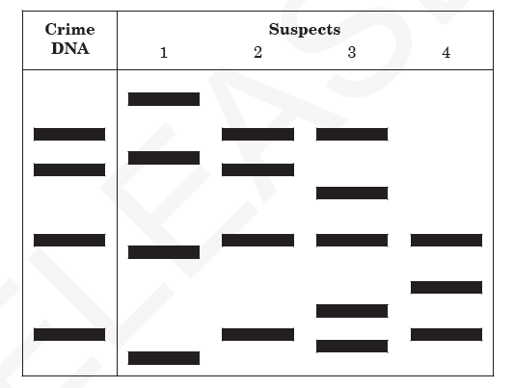
15. This diagram represents samples of DNA that were cut with a restriction enzyme during DNA fingerprinting in a crime lab.
Which technique was used to produce these bands?
a. cloning
b. gel electrophoresis
c. gene splicing
d. genetic engineering

Slide 17
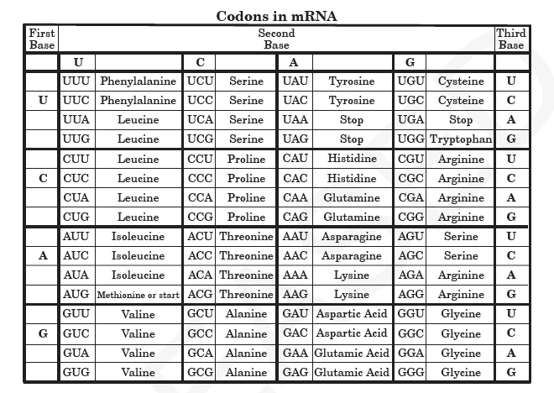
16. This chart represents amino acids that are coded from different combinations of mRNA codons.
Which amino acid sequence can be coded from the DNA sequence CAG TAG CGA?
a. Valine- Isoleucine- Glycine
b. Valine- Aspartic Acid- Alanine
c. Valine- Isoleucine- Alanine
d. Valine- Phenylalanine- Alanine

Slide 18
This chart represents amino acids that are coded from different combinations of mRNA codons.
17. Refer to the Codon chart above. A strand of DNA with the sequence CAC AAG CCC undergoes a mutation, and the first A is changed to a C. How will this mutation affect the amino acid sequence?
a. One amino acid will change.
b. Two amino acids will change.
c. All of the amino acids will change.
d. The amino acids will remain the same.

Slide 19
18. One of the parents of a child has phenylketonuria (PKU), which is caused by recessive alleles. The other parent does not have the PKU alleles. What is the chance that the couple will have a child with phenylketonuria?
a. O%
b. 50%
c. 75%
d. 100%

Slide 20
19. A scientist treats a cell with a chemical that destroys the ribosomes. As a result, which cell process will be stopped?
a. osmosis
b. photosynthesis
c. protein synthesis
d. respiration

Slide 21
20. Hitchhiker’s thumb (H) is dominant to no hitchhiker’s thumb (h). A woman who does not have hitchhiker’s thumb marries a man who is heterozygous for hitchhiker’s thumb. What is the probable genotypic ratio of their children?
Hint: Complete a punnett square!
a. 0% Hh : 100% hh
b. 50% Hh : 50% hh
c. 75% Hh : 25% hh
d. 100% Hh : 0% hh

Slide 22
21. A sugar, a phosphate group, and a nitrogen base form the building blocks of which organic compound?
a. carbohydrates
b. lipids
c. nucleic acids
d. proteins

Slide 23
22. A genetic counselor is examining a karyotype from a patient when an extra copy of chromosome 13 is noticed. This condition is referred to as
a. trisomy
b. diploidy
c. triploidy
d. monosomy

