Slide 1
Practice Exam
2019

Slide 2
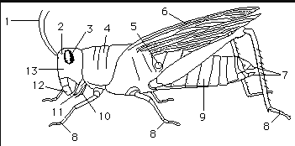
What is structure indicated by number 5?
Tympanum Membrane

Slide 3
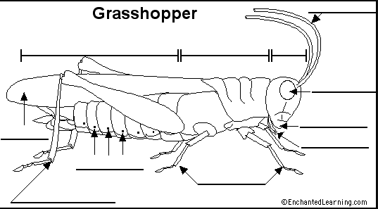
What is the structures indicated by letter A?
A
Spiracles

Slide 4
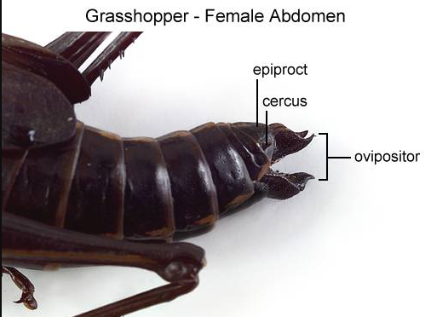
Is this grasshopper male or female?
Female

Slide 5
What structure is the red arrow pointing too?
Ovipositor

Slide 6
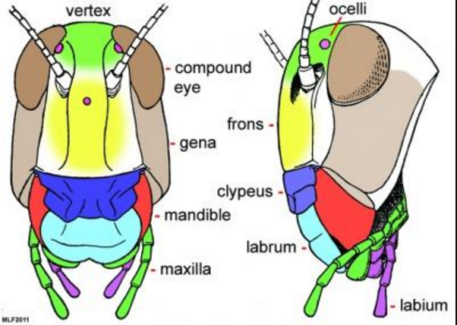
What structure is represented in teal?
Labrum
What structure is represented in yellow?
Frons
What structure is represented in purple?
Labium

Slide 7
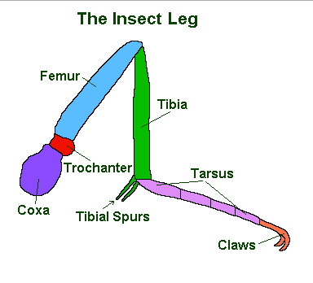
What structure is represented in green?
Tibia
What structure is represented in lighter purple/fuchsia color?
Tarsus
What structure is represented in darker purple?
Coxa

Slide 8
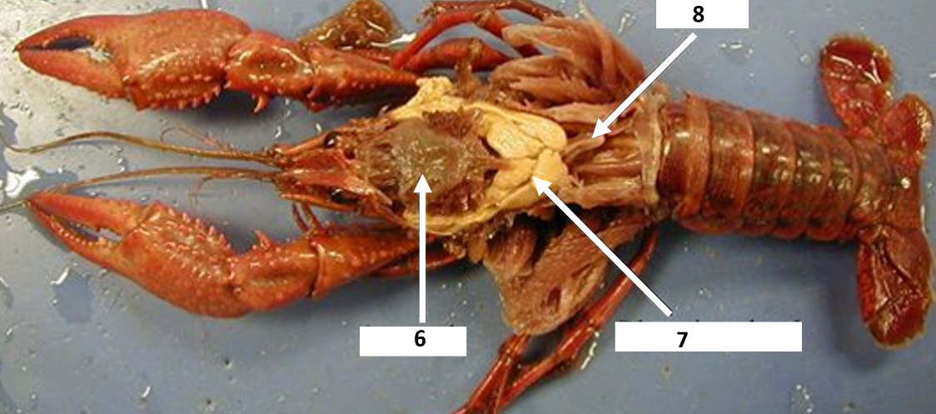
What structure is indicated by number 6 in this picture?

Slide 9
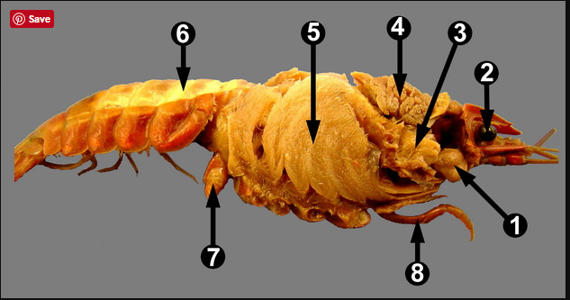
What structure is indicated by number 5 in this picture?
Gills

Slide 10
56. What structure is indicated by number 1 in this picture?

Slide 11
What structure is indicated by number 2 in this picture?

Slide 12
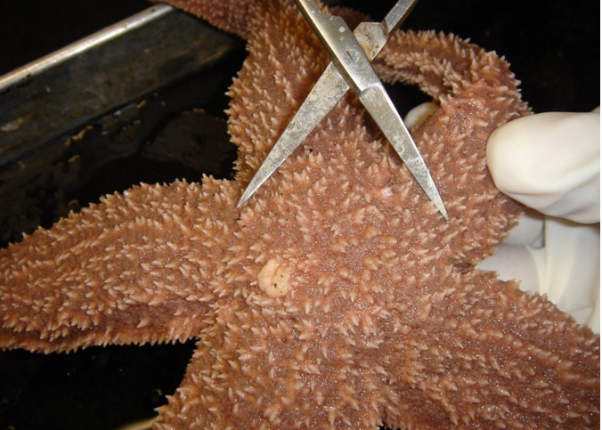
57. What is the structure indicated by the yellow arrow?

Slide 13
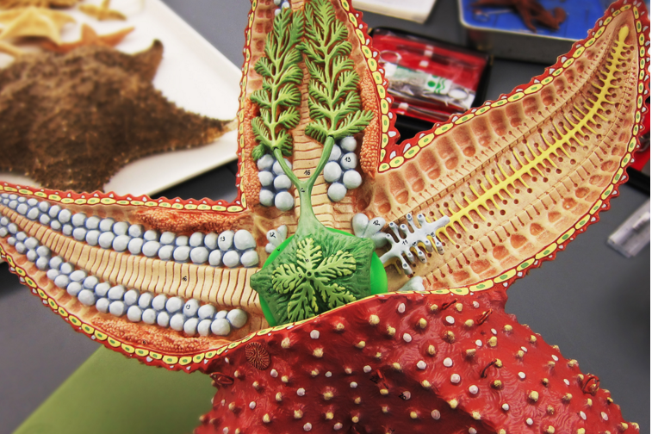
What is the structure indicated by the yellow arrow?
Eggs

Slide 14
What is the structure indicated by the yellow arrow?
Pyloric Cecum

Slide 15
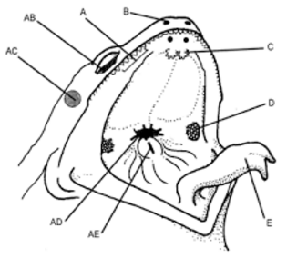
What structure is indicated by letter C in this picture?
Vomerine Teeth
What membrane is indicated by letter AB in this picture?
Nictating Membrane
What does this function/ purpose of this membrane?
See underwater

Slide 16
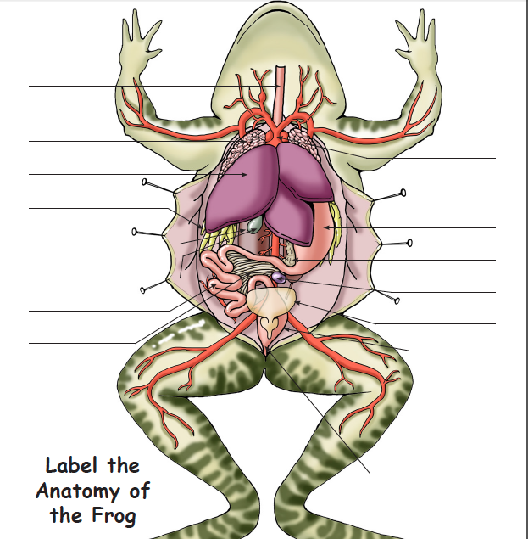
What structure is indicated by letter red arrow?
A
C
Liver
B
D
What is its function?
E
Produce Bile/ Detoxify blood
F

Slide 17
What structure is indicated by letter red arrow (yellow strings)
A
C
Fat Bodies
B
D
What is its function?
Long-term energy
E
F

Slide 18
What structure is indicated by letter red arrow?
A
C
Bladder
B
D
E
F

Slide 19
What structure is indicated by letter red arrow (green bulb)?
A
C
Gall Bladder
B
D
What is its function?
Store Bile
E
F

Slide 20
What structure is indicated by letter red arrow (green bulb)?
A
C
Lungs
B
D
What is its function?
Exchange O2 and CO2
E
F

Slide 21
What letter is the Yolk Sac?
D
Chorion
Allantois
E
C
E
Amnion
Yolk sac
B
Embryo
Amniotic cavity with amniotic fluid
What is its function
Provide Energy
Yolk
(nutrients)
F
Shell
Albumen
A

Slide 22
What letter is the Allantois?
D
Chorion
Allantois
C
C
E
Amnion
Yolk sac
B
Embryo
Amniotic cavity with amniotic fluid
What is its function
Store waste
Yolk
(nutrients)
Shell
Albumen
A

Slide 23
What letter is the Amnion?
D
Chorion
Allantois
B
C
E
Amnion
Yolk sac
B
Embryo
Amniotic cavity with amniotic fluid
What is its function
Provide watery cushion and protection
Yolk
(nutrients)
Shell
Albumen
A

Slide 24
Matching:
C
A. Eggs laid outside mother
1. Vivipary
A
B. Eggs develop inside mother and live births
2. Ovipary
3. Ovovipary
B
C. live birth via placental connection

Slide 25
This structure adjust the buoyancy in fish?
A. Lateral Line
B. Swim Bladder
C. Operculum
D. Caudal Fin

Slide 26
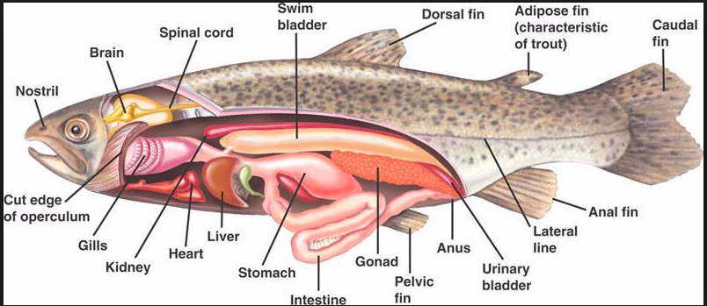
What structure is indicated by letter red arrow
How many chambers?
Heart
Two
v

Slide 27
What structure is indicated by letter red arrow
Liver
v

Slide 28
What structure is indicated by letter red arrow
Kidney
v

Slide 29
What structure is indicated by letter red arrow
Swim Bladder
v

Slide 30
What structure is indicated by letter red arrow
Reproductive Organ
v

Slide 31
What structure is indicated by letter red arrow
What is its function?
Detect vibrations in H₂O
Lateral Line
v

Slide 32
Myxini
Cephalaspidomorphi
Chondrichthyes
A
C
B
A
B
C

Slide 33
Cephalochorata
Urochordata
A
B
B: Sea Squirts
A: Amphioxus

Slide 34
What structure is indicated by letter red arrow
Pharyngeal Gill Slits

Slide 35
What structure is indicated by letter red arrow
Dorsal Hollow Nerve Cord

Slide 36
What structure is indicated by letter red arrow
Notochord

Slide 37
Which of the phyla below is the largest and most successful in terms of number of species?
Mollusca
Arthropoda
Echinodermata
Vertebrata

Slide 38
Which of the following is not a reason why Arthropods are so successful
Complex behavior
Metamorphosis
Spiracles
Exoskeleton
Primary Consumers of plants

Slide 39
What is a negative consequence of having an exoskeleton instead of an endoskeleton?
Slow growth
Limits water loss
Limits size
No weaknesses

Slide 40
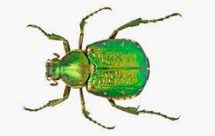
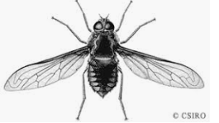
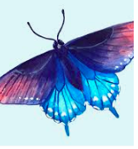
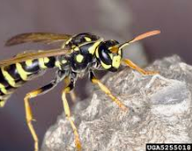
Hymenoptera
Coleoptera
Lepidoptera
Diptera
D
A
C
B
A
B
C
D

Slide 41
Antennae
Antennules
A
A
B
B

Slide 42
What structure is indicated by number 6 in this picture?
Pyloric Stomach

Slide 43
What structure is indicated by number 7 in this picture?
Digestive Gland

Slide 44
What structure is indicated by number 8 in this picture?
Heart

Slide 45
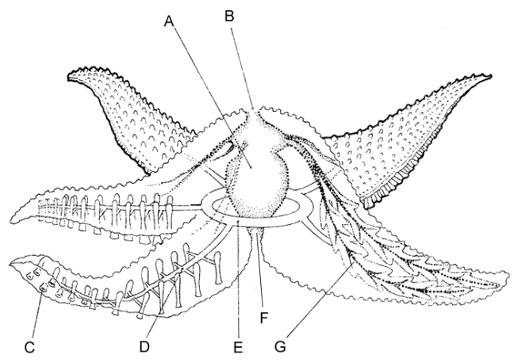
What structure is letter A?
Cardiac Stomach

Slide 46
What structure is letter B?
Pyloric Stomach

Slide 47
What is the proper flow of water through the water vascular system?
Madreporite
Stone Canal
Ring Canal
Radial Canal
Lateral Canal
Ampullae
Tube Feet

Slide 48
What structure is indicated by letter red arrow
Gills

Slide 49
What structure is indicated by letter red arrow
Heart

Slide 50
What structure is indicated by letter red arrow
Reproductive Gland

Slide 51
What structure is indicated by letter red arrow
Digestive Gland

Slide 52
What structure is indicated by letter red arrow
Stomach

Slide 53
What structure is indicated by letter red arrow
Intestines

Slide 54
What structure is indicated by letter red arrow
Foot

