Slide 1
Session 3b
DNA; Mutations; and Genetics

Slide 2
This chart shows the results of several crosses with white-feathered chickens and dark-feathered chickens.
1. Which cross would be represented as Aa x aa, where (A) represents a dominant allele and (a) represents a recessive allele?
a. Cross 1 b. Cross 2
c. Cross 3 d. Cross 4
Cross | Parental Feather Colors | Offspring Feather Colors
1 | White x White | 100% White
2 | White x White | 75% White, 25% Dark
3 | White x Dark | 50% White, 50% Dark
4 | Dark x Dark | 100% Dark

Slide 3
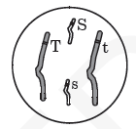
This diagram shows a diploid cell with two pairs of homologous chromosomes.
Due to independent assortment, what is the possible genetic make-up of gametes produced by this organism?
a. SsTt
b. SS, Tt
c. S, s, T, t
d. ST, St, sT, st

Slide 4
3. Which genetic abnormality can be identified through karyotyping?
a. point mutation
b. recessive allele
c. extra chromosome
d. sex-linked allele

Slide 5
4. During DNA replication, which of the following segments would be complementary to the original DNA segment of CCTAAT?
a. CGATTA
b. GGUTTU
c. GGATTA
d. GGAUUA

Slide 6
5. What type of RNA is responsible for bringing amino acids to the ribosome for protein synthesis?
a. messenger RNA
b. transfer RNA
c. ribosomal RNA
d. mitochondrial RNA

Slide 7
6. To determine the molecular sequence of a gene for a protein, which molecule should be analyzed?
a. tRNA
b. ATP
c. DNA
d. rRNA

Slide 8
7. If a portion of a DNA strand has the base sequence TACGCA, what will be the base sequence of the mRNA strand transcribed?
a. TACGCA
b. UACGCA
c. AUGCGU
d. ATGCGT

Slide 9
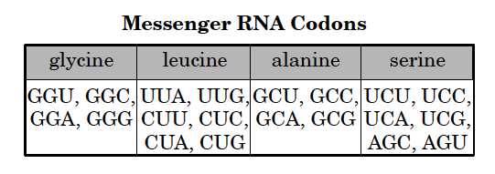
8. The chart to the right matches messenger RNA codons with amino acids.
DNA strand has the codon TCA. According to the chart, the corresponding messenger RNA codes for which of the following amino acids?
a. glycine
b. leucine
c. alanine
d. serine

Slide 10
9. In a genetics laboratory, two heterozygous tall plants are crossed. If tall is dominant over short, what are the expected phenotypic results?
a. 100% tall
b. 75% tall, 25% short c. 50% tall, 50% short
d. 25% tall, 75% short

Slide 11
10. When viewing a karyotype to detect genetic disorders, which of the following would be a concern?
a. different chromosomes of different lengths
b. two X chromosomes
c. twenty-three pairs of chromosomes
d. three chromosomes in any one set

Slide 12
11. Color blindness is a sex-linked recessive trait. A mother with normal color vision and a color blind father have a color blind daughter. Which of the following statements is correct?
a. All of their daughters will be color blind.
b. The mother is a carrier of the color blindness gene.
c. All of their sons will have normal color vision.
d. All of their sons will be color blind.

Slide 13
12. After performing amniocentesis, which analysis is most often used to determine the chromosomal condition of a developing fetus?
a. blood type
b. DNA sequence
c. genetic marker
d. karyotype

Slide 14
13. Albinism is a genetic mutation that results in some animals being born without the enzyme that produces the pigment for skin and eye color. Which of the following best explains this mutation?
a. The DNA failed to replicate.
b. The deoxyribose sugar became separated from the DNA.
c. The genetic code change caused the wrong protein to form.
d. The RNA necessary to produce proteins was not present.

Slide 15
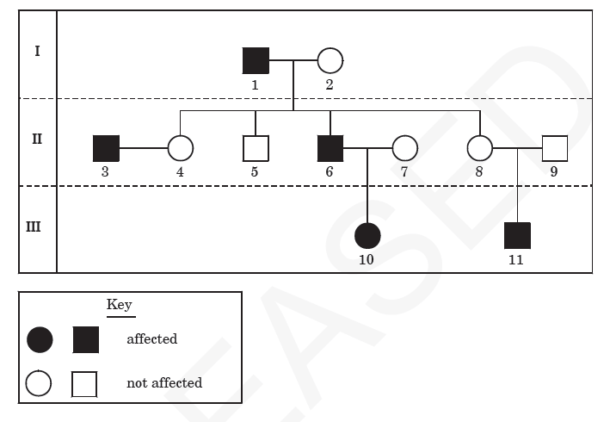
14. This diagram shows a pedigree for a recessive genetic disorder.
What is the genotype of individual 6?
a. X^{H}X^{H} b. X^{H}X^{h}
c. X^{H}Y d. X^{h}Y

Slide 16
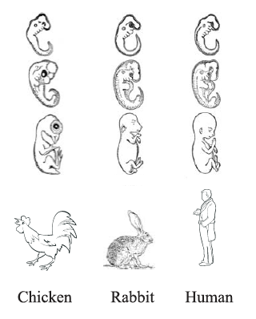
15. The figure to the right shows embryonic stages of three different kinds of organisms.
What does the figure suggest about these organisms?
a. They underwent similar mutations.
b. The share the same acquired traits.
c. They originated in the same location.
d. They show similar embryonic development.

Slide 17
16. How do the functions of DNA and RNA differ?
a. DNA directs protein transport, while RNA aids in energy production.
b. DNA aids in energy production, while RNA directs protein transport.
c. DNA stores genetic information, while RNA relays genetic information for protein synthesis.
d. DNA relays genetic information for protein synthesis, while RNA stores genetic information.

Slide 18
17. One way in which a point mutation and a deletion mutation are different is that
a. a point mutation is always harmful, and a deletion mutation is never harmful
b. a point mutation is a physical change, and a deletion mutation is a chemical change
c. a point mutation always results in a frameshift mutation, while a deletion mutation never results in a frameshift mutation
d. a point mutation only results in a change in a single nucleotide base, while a deletion mutation can result in a change in multiple nucleotide bases

Slide 19
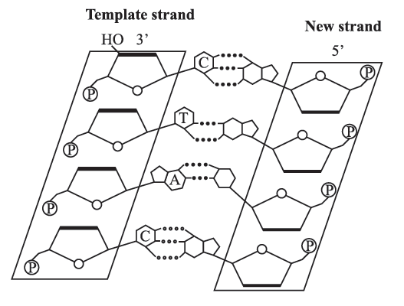
18. The illustration below shows a step in DNA replication.
Starting at the top, which list shows the identity of the bases of the new strand?
a. A, G, T, A
b. G, A, T, G
c. G, A, U, G
d. A, G, U, A

Slide 20
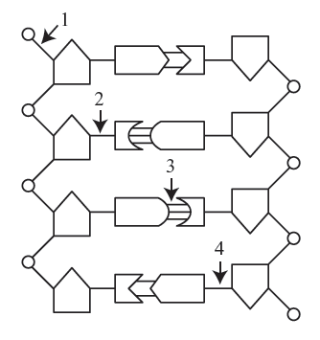
19. The graphic below represents a segment of DNA.
Which bond must be broken if DNA replication is to occur?
a. 1
b. 2
c. 3
d. 4

Slide 21
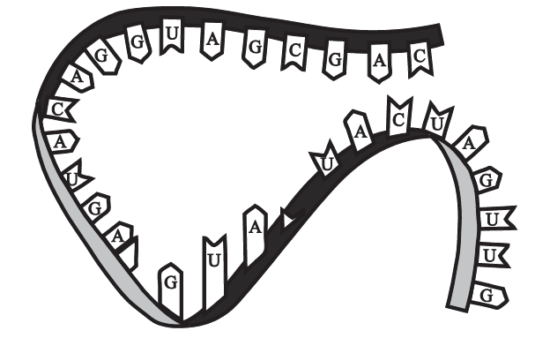
20. The figure to the right shows genetic material.
What information confirms that this is an RNA molecule?
a. The molecule contains adenine.
b. The molecule is single-stranded.
c. The molecule has hydrogen bonds.
d. The molecule has a sugar-phosphate backbone.

Slide 22
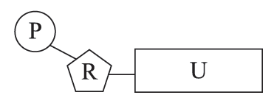
21. The figure to the right shows an RNA molecule found within the cell.
What does the letter U represent in this nucleotide?
a. ribose sugar
b. nitrogen base
c. phosphate group
d. deoxyribose sugar

Slide 23
22. What is the role of hydrogen bonds in the structure of DNA?
a. to code for proteins
b. to synthesize proteins
c. to separate the strands
d. to connect the base pairs

